Slide 1

Shadow: Simple HPC for Systems Security Research
Invited Talk
Kansas State University
September 25th, 2013
Rob Jansen
U.S. Naval Research Laboratory
rob.g.jansen@nrl.navy.mil

Slide 2
Outline
Experimentation Ideology
Shadow and its Design
Use case:
Overview: the Distributed Tor Network
Research: the Sniper Attack Against Tor

Slide 3
Outline
Experimentation Ideology
Shadow and its Design
Use case:
Overview: the Distributed Tor Network
Research: the Sniper Attack Against Tor

Slide 4
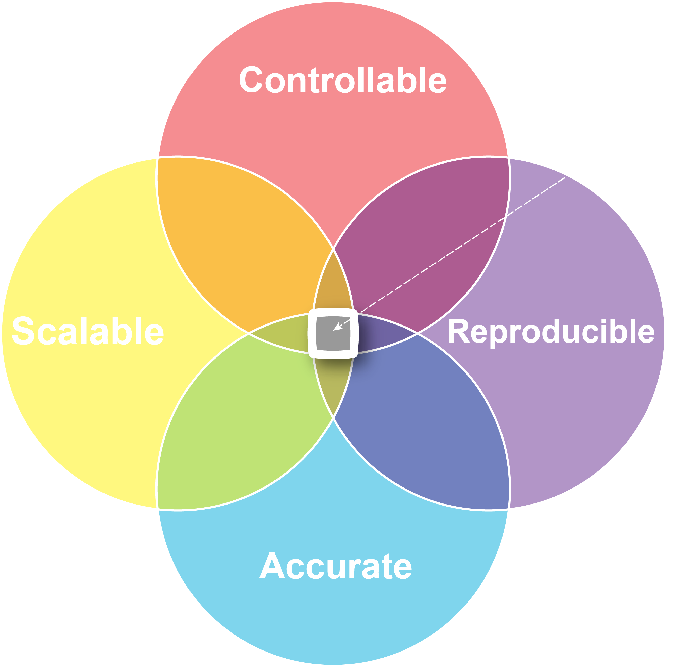
Properties of Experimentation

Slide 5

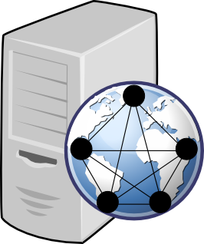
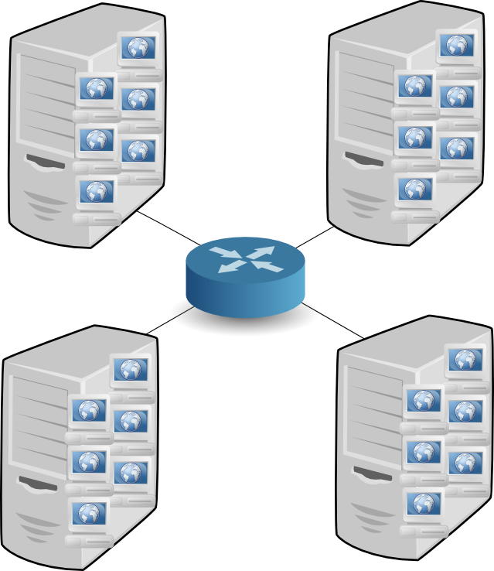
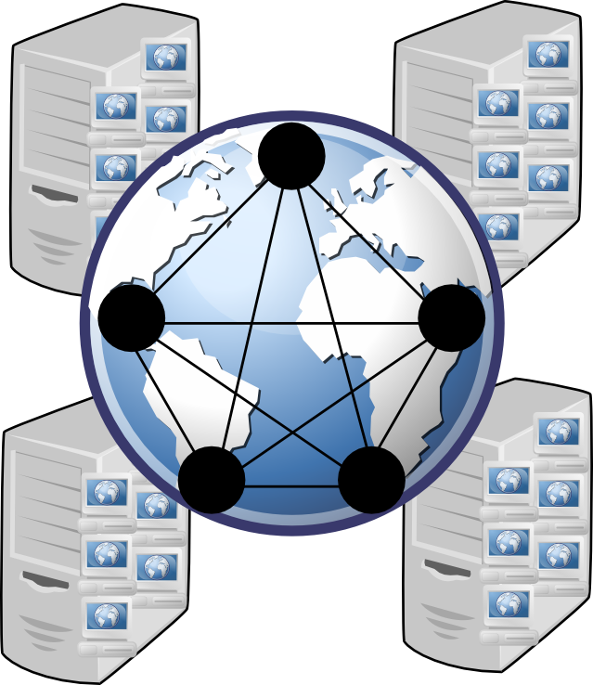
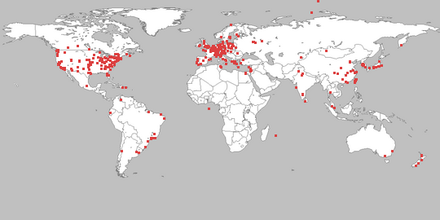
Network Research
Approaches | Problems
Live Network | Hard to manage, lengthy deployment, security risks
PlanetLab | Hard to manage, bad at modeling, not scalable
Simulation | Not generalizable, inaccurate
Emulation | Large overhead, kernel complexities

Slide 6
Testbed Trade-offs
 | Controllable | Reproducible | Scalable | Accuracy | Convenient
Live Network |  |  | X | X
PlanetLab |  |  |  | ?
Simulation | X | X | X |  | X
Emulation | X |  |  |  | X
Shadow | X | X | X | ? | X

Slide 7
Outline
Experimentation Ideology
Shadow and its Design
Use case:
Overview: the Distributed Tor Network
Research: the Sniper Attack Against Tor

Slide 8
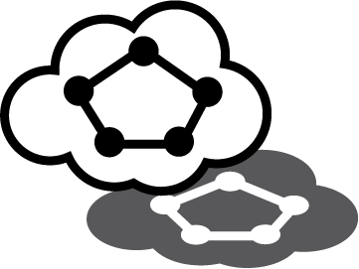
What is Shadow?
Discrete event network simulator
Runs real applications without modification
Simulates time, network, crypto, CPU
Models routing, latency, bandwidth
Single Linux box without root privileges
Notes:
Processing tasks are represented as events, each occurs at a discrete time
Test prototypes during development
Accurately models bandwidth and latency using Internet measurements
Efficient – high CPU utilization during simulation
Scalable – since time is simulated, we can run faster or slower than real time to allow arbitrarily sized networks
Runs on any machine running linux, usable by researchers anywhere, anytime

Slide 9
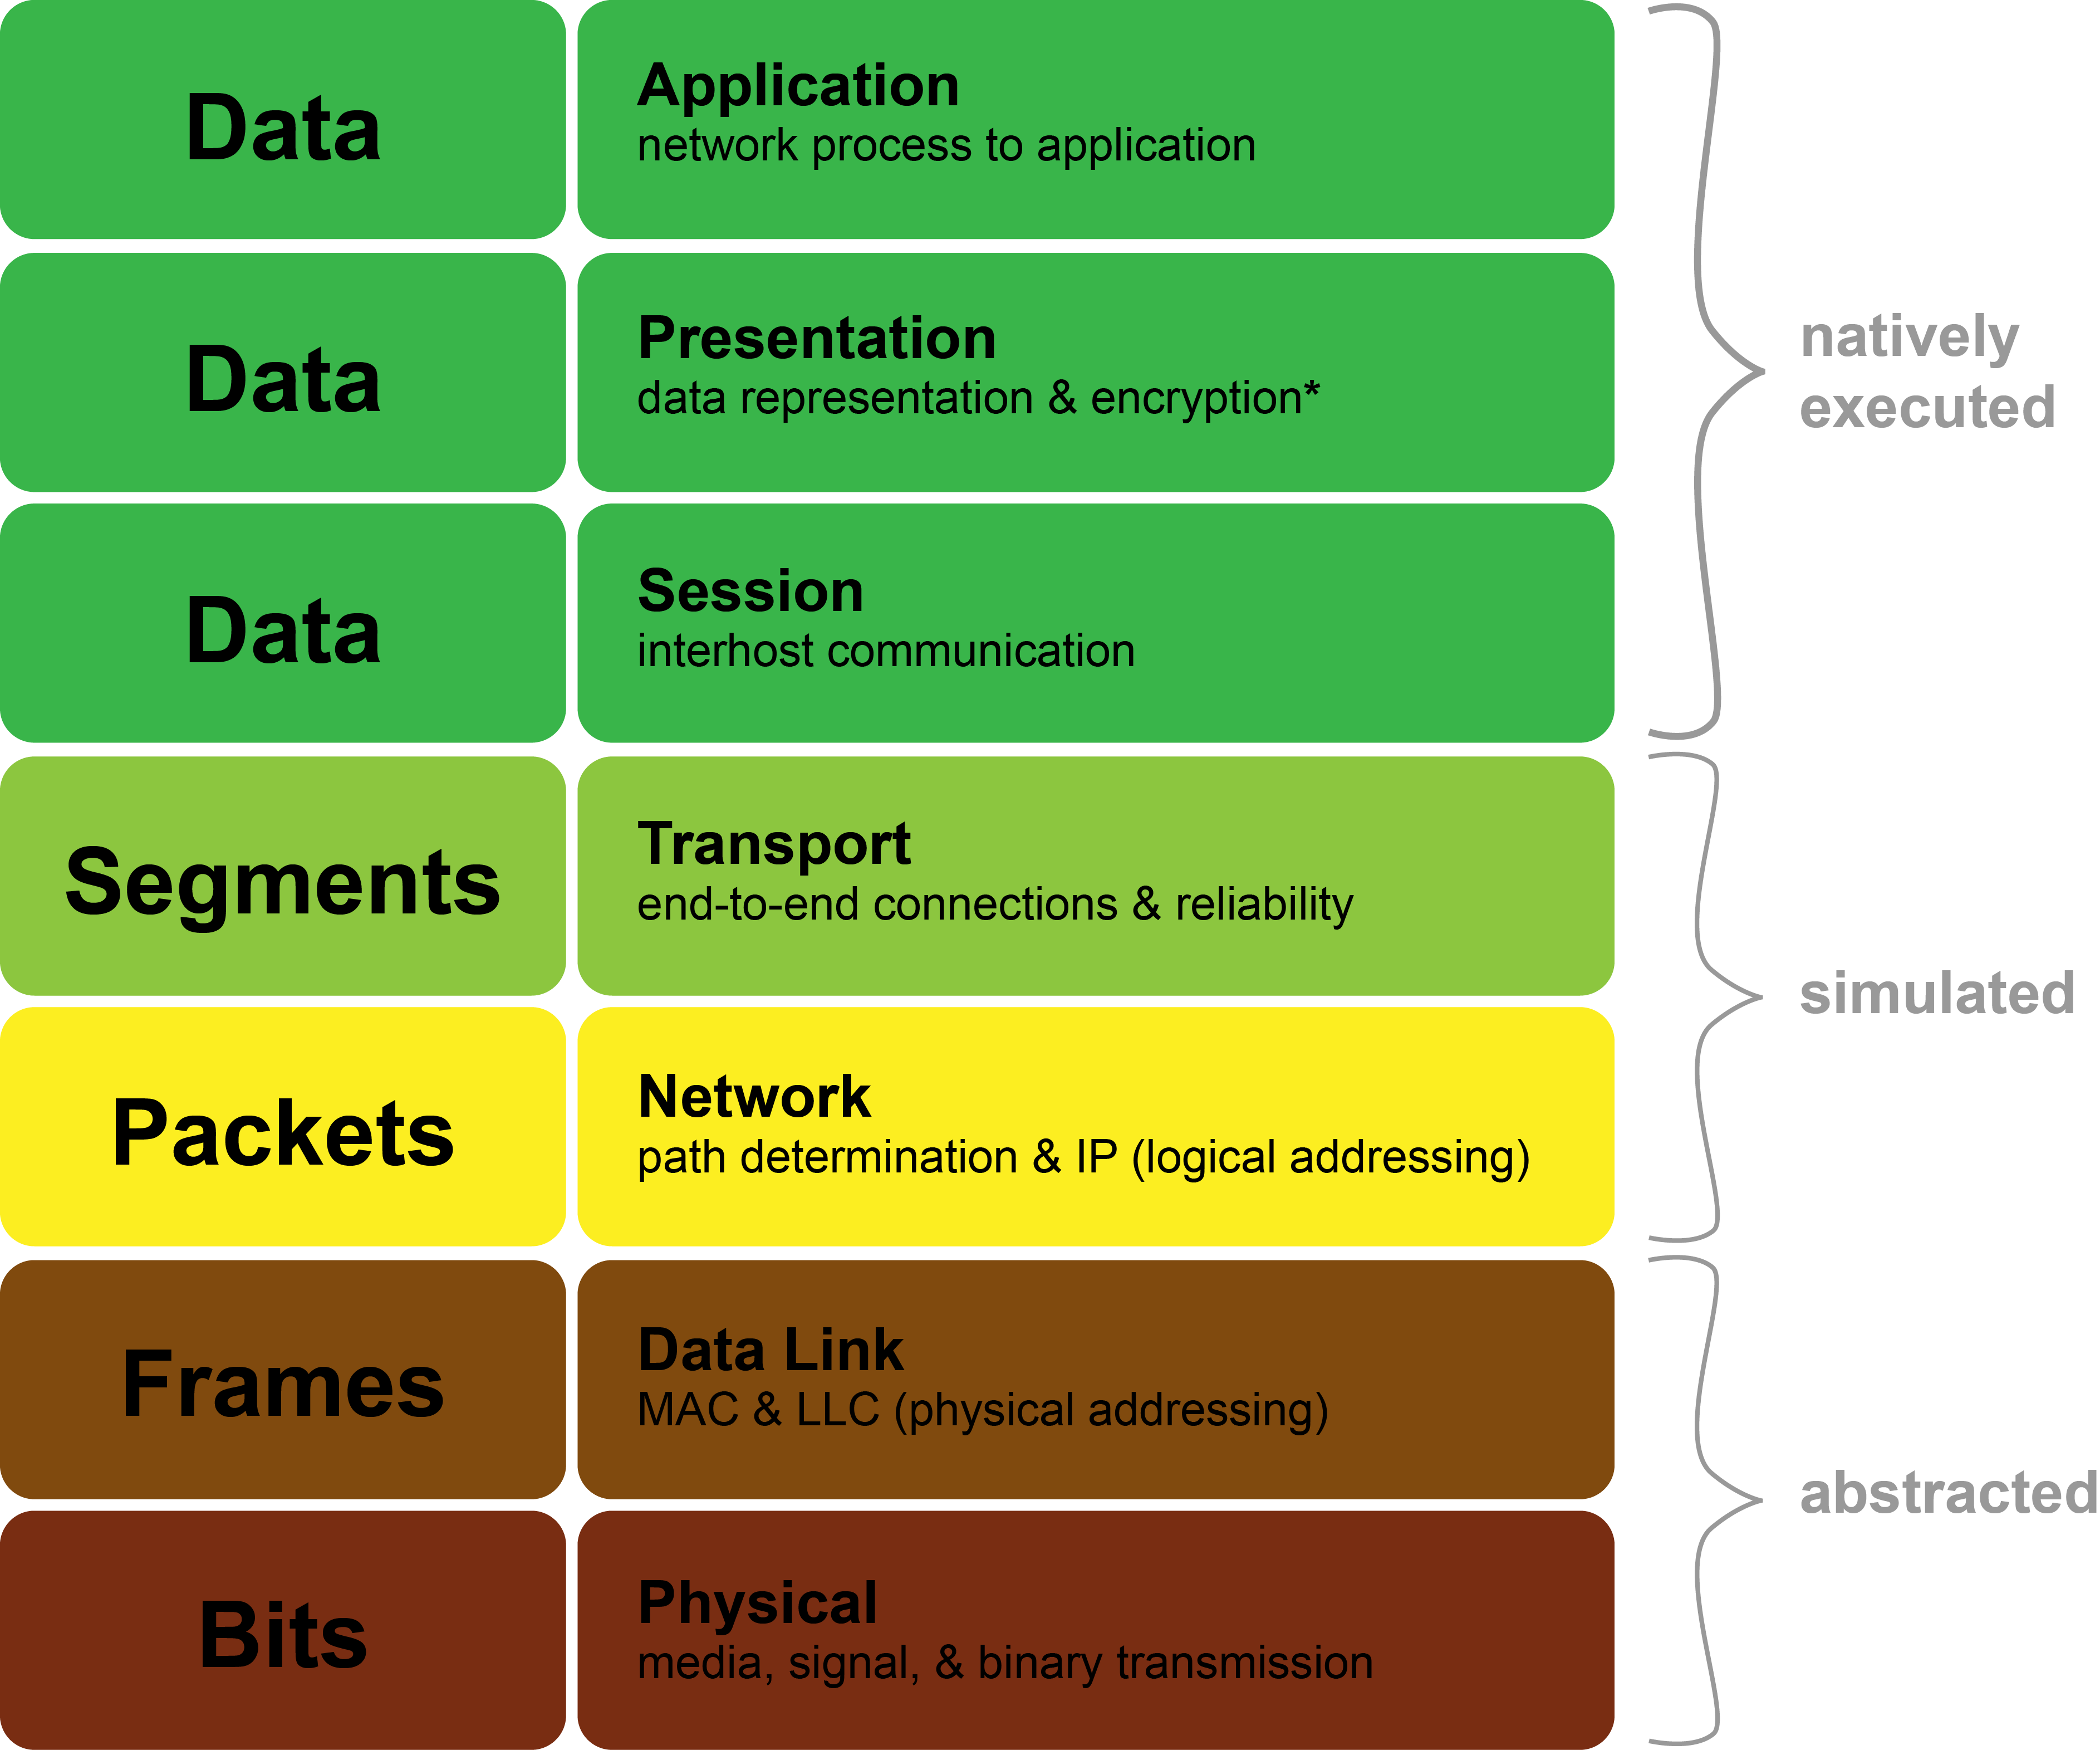
Shadow’s Capabilities

Slide 10
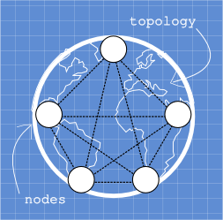
Bootstrapping Shadow
Notes:
Blueprint contains network structure and bootstraps the simulation
Nodes are created, each runs a given plugin application
Manage nodes with memory swapping
Intercept network functions which queues new events

Slide 11
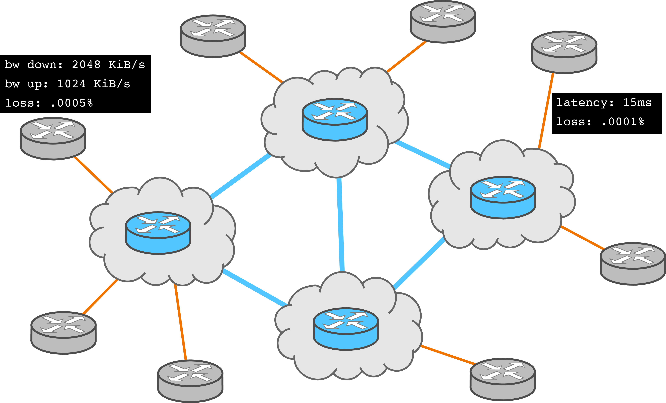
Virtual Network Configuration

Slide 12
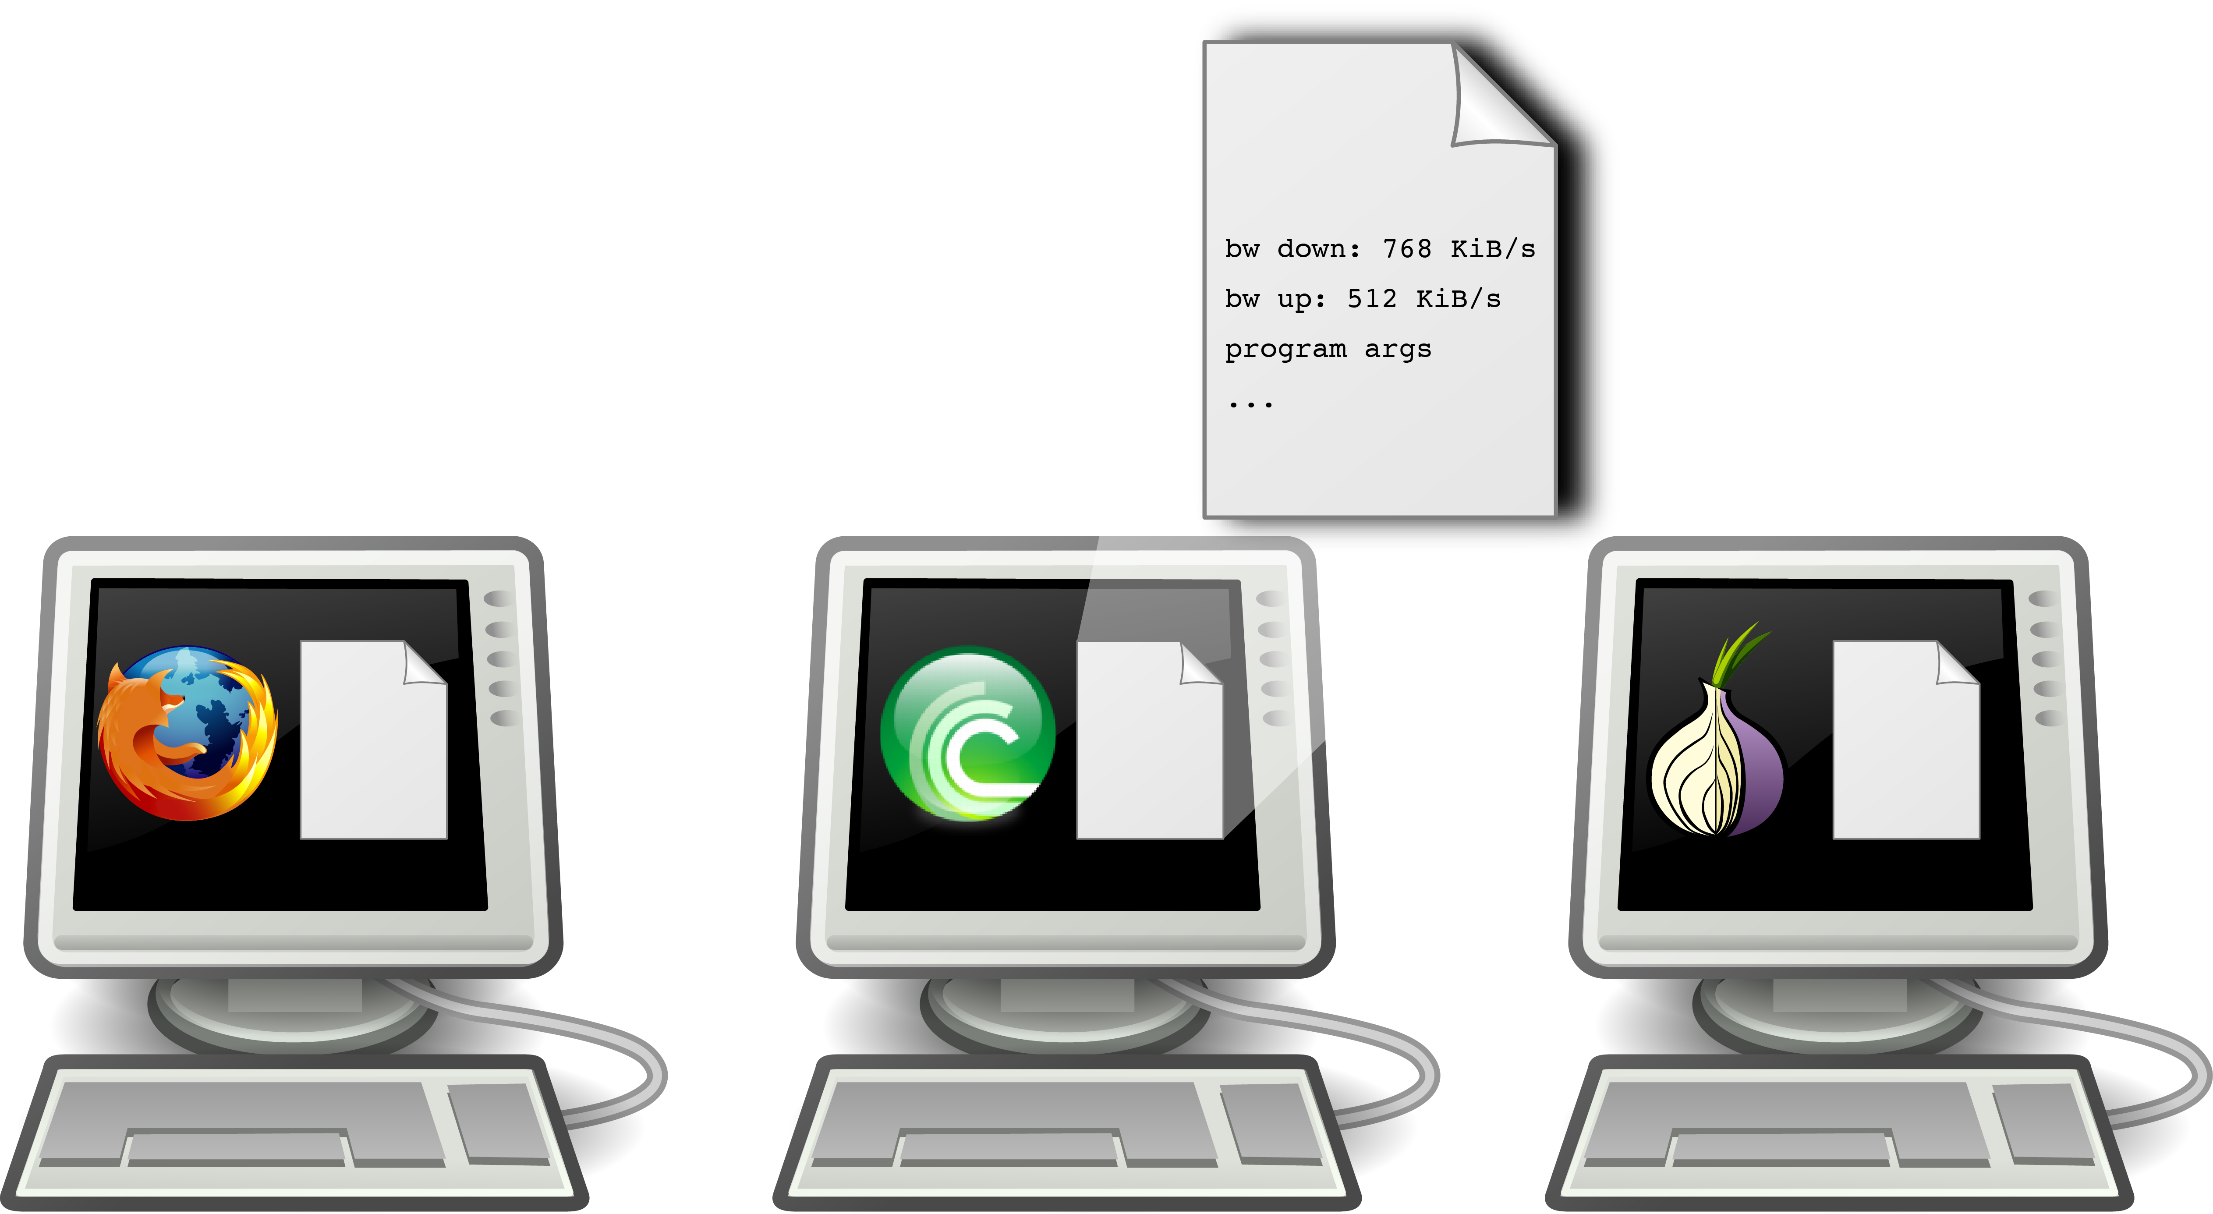
Virtual Host Configuration

Slide 13
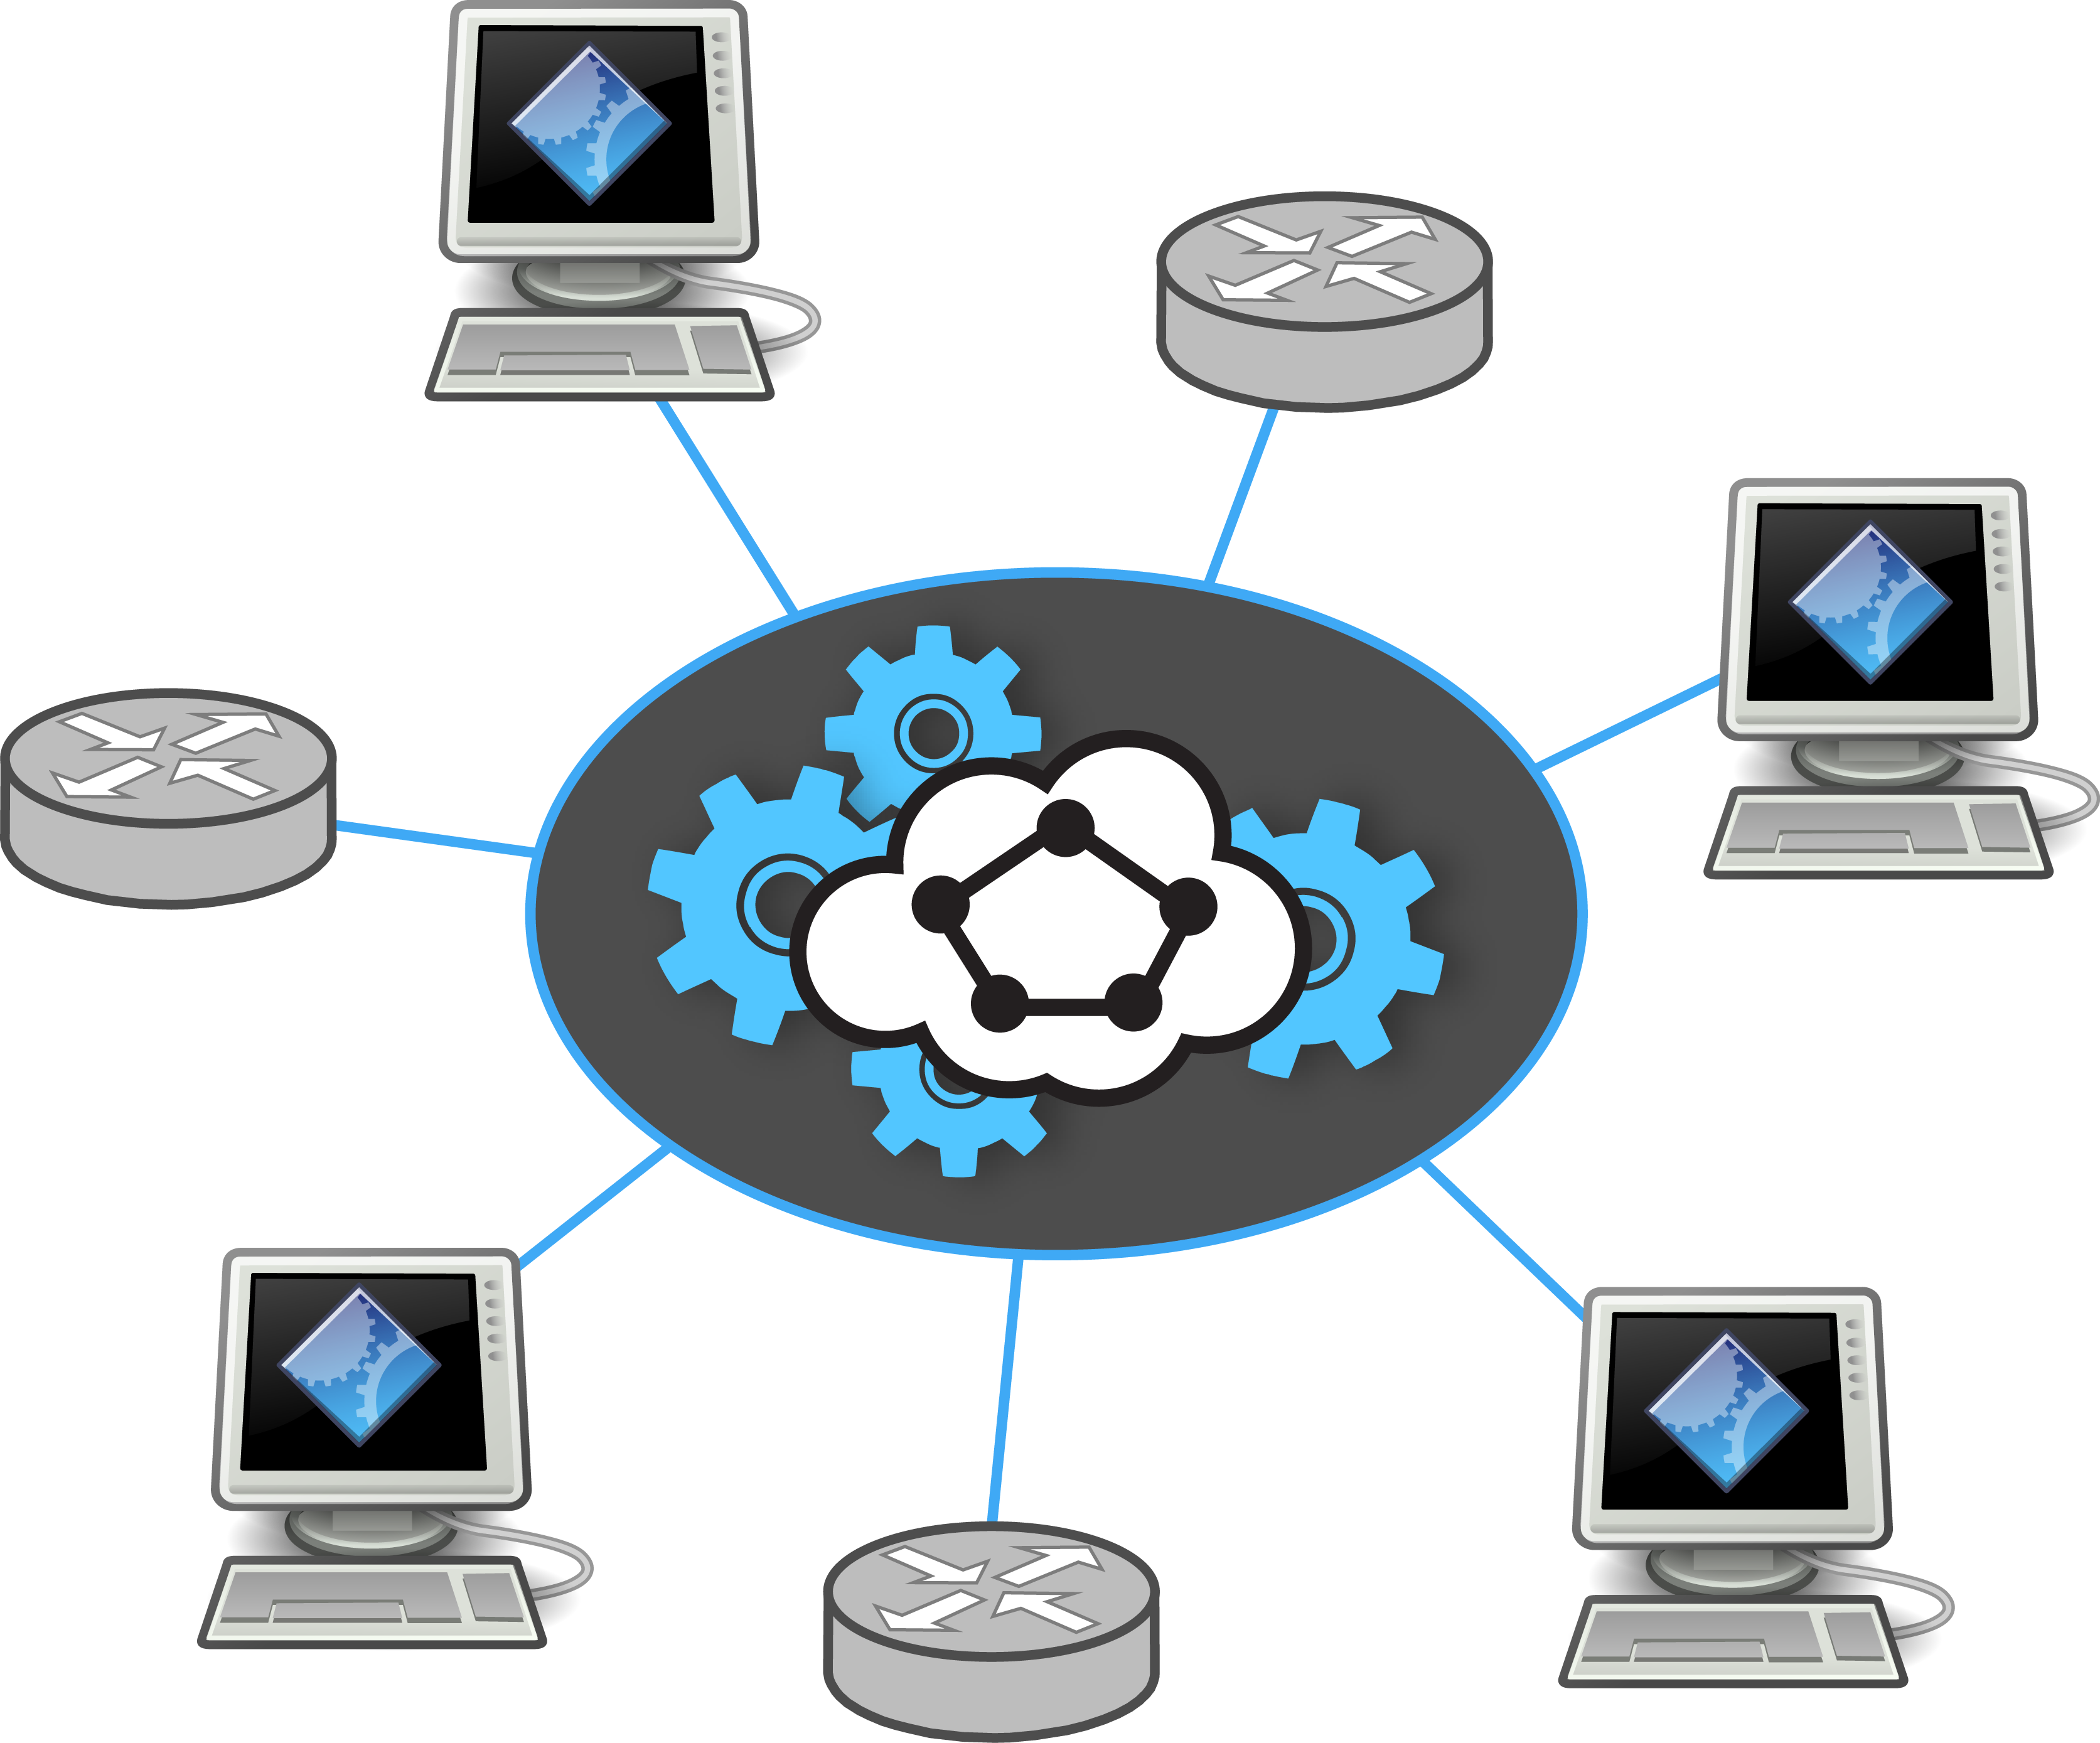
Simulation Engine

Slide 14
Program Layout
Shadow Engine
(shadow-bin)
Shadow
Plug-in
(application+wrapper)
Libraries
(libc, …)

Slide 15
Plug-in Wrapper Hooks
plugin_init()
new_instance(argv, argc)
free_instance()
instance_notify()
Shadow Engine
(shadow-bin)
Shadow
Plug-in
(application+wrapper)
Libraries
(libc, …)

Slide 16
Function Interposition
LD_PRELOAD=/home/rob/libpreload.so
libpreload (socket, write, …)
Shadow Engine
(shadow-bin)
Shadow
Plug-in
(application+wrapper)
Libraries
(libc, …)

Slide 17
Function Interposition
LD_PRELOAD=/home/rob/libpreload.so
libpreload (socket, write, …)
Shadow Engine
(shadow-bin)
Shadow
Plug-in
(application+wrapper)
Libraries
(libc, …)
hooks

Slide 18
Function Interposition
LD_PRELOAD=/home/rob/libpreload.so
libpreload (socket, write, …)
Shadow Engine
(shadow-bin)
Shadow
Plug-in
(application+wrapper)
Libraries
(libc, …)
hooks
fopen

Slide 19
Function Interposition
LD_PRELOAD=/home/rob/libpreload.so
libpreload (socket, write, …)
socket
Shadow Engine
(shadow-bin)
Shadow
Plug-in
(application+wrapper)
Libraries
(libc, …)
hooks
fopen

Slide 20
Function Interposition
LD_PRELOAD=/home/rob/libpreload.so
libpreload (socket, write, …)
write
Shadow Engine
(shadow-bin)
Shadow
Plug-in
(application+wrapper)
Libraries
(libc, …)
hooks
fopen

Slide 21
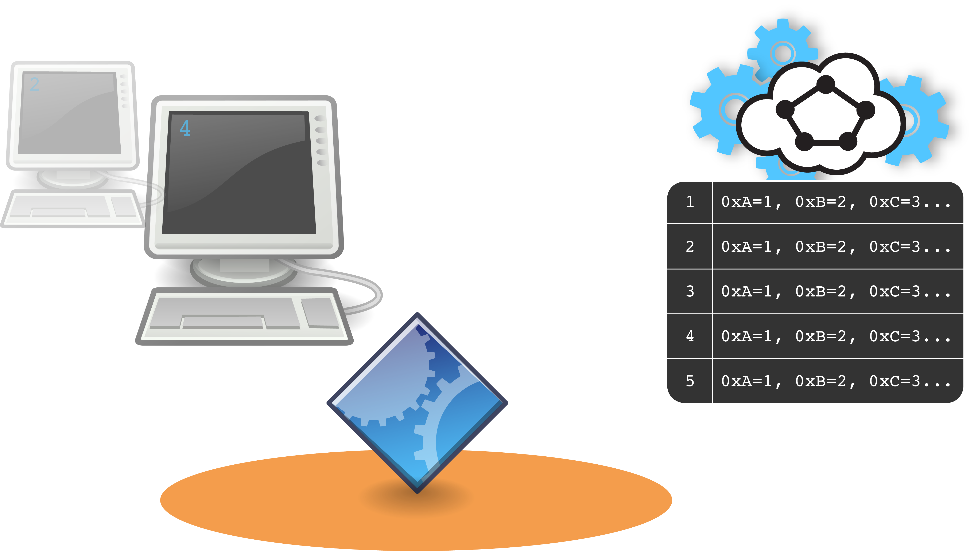
Virtual Context Switching
Clang/LLVM (custom pass)

Slide 22
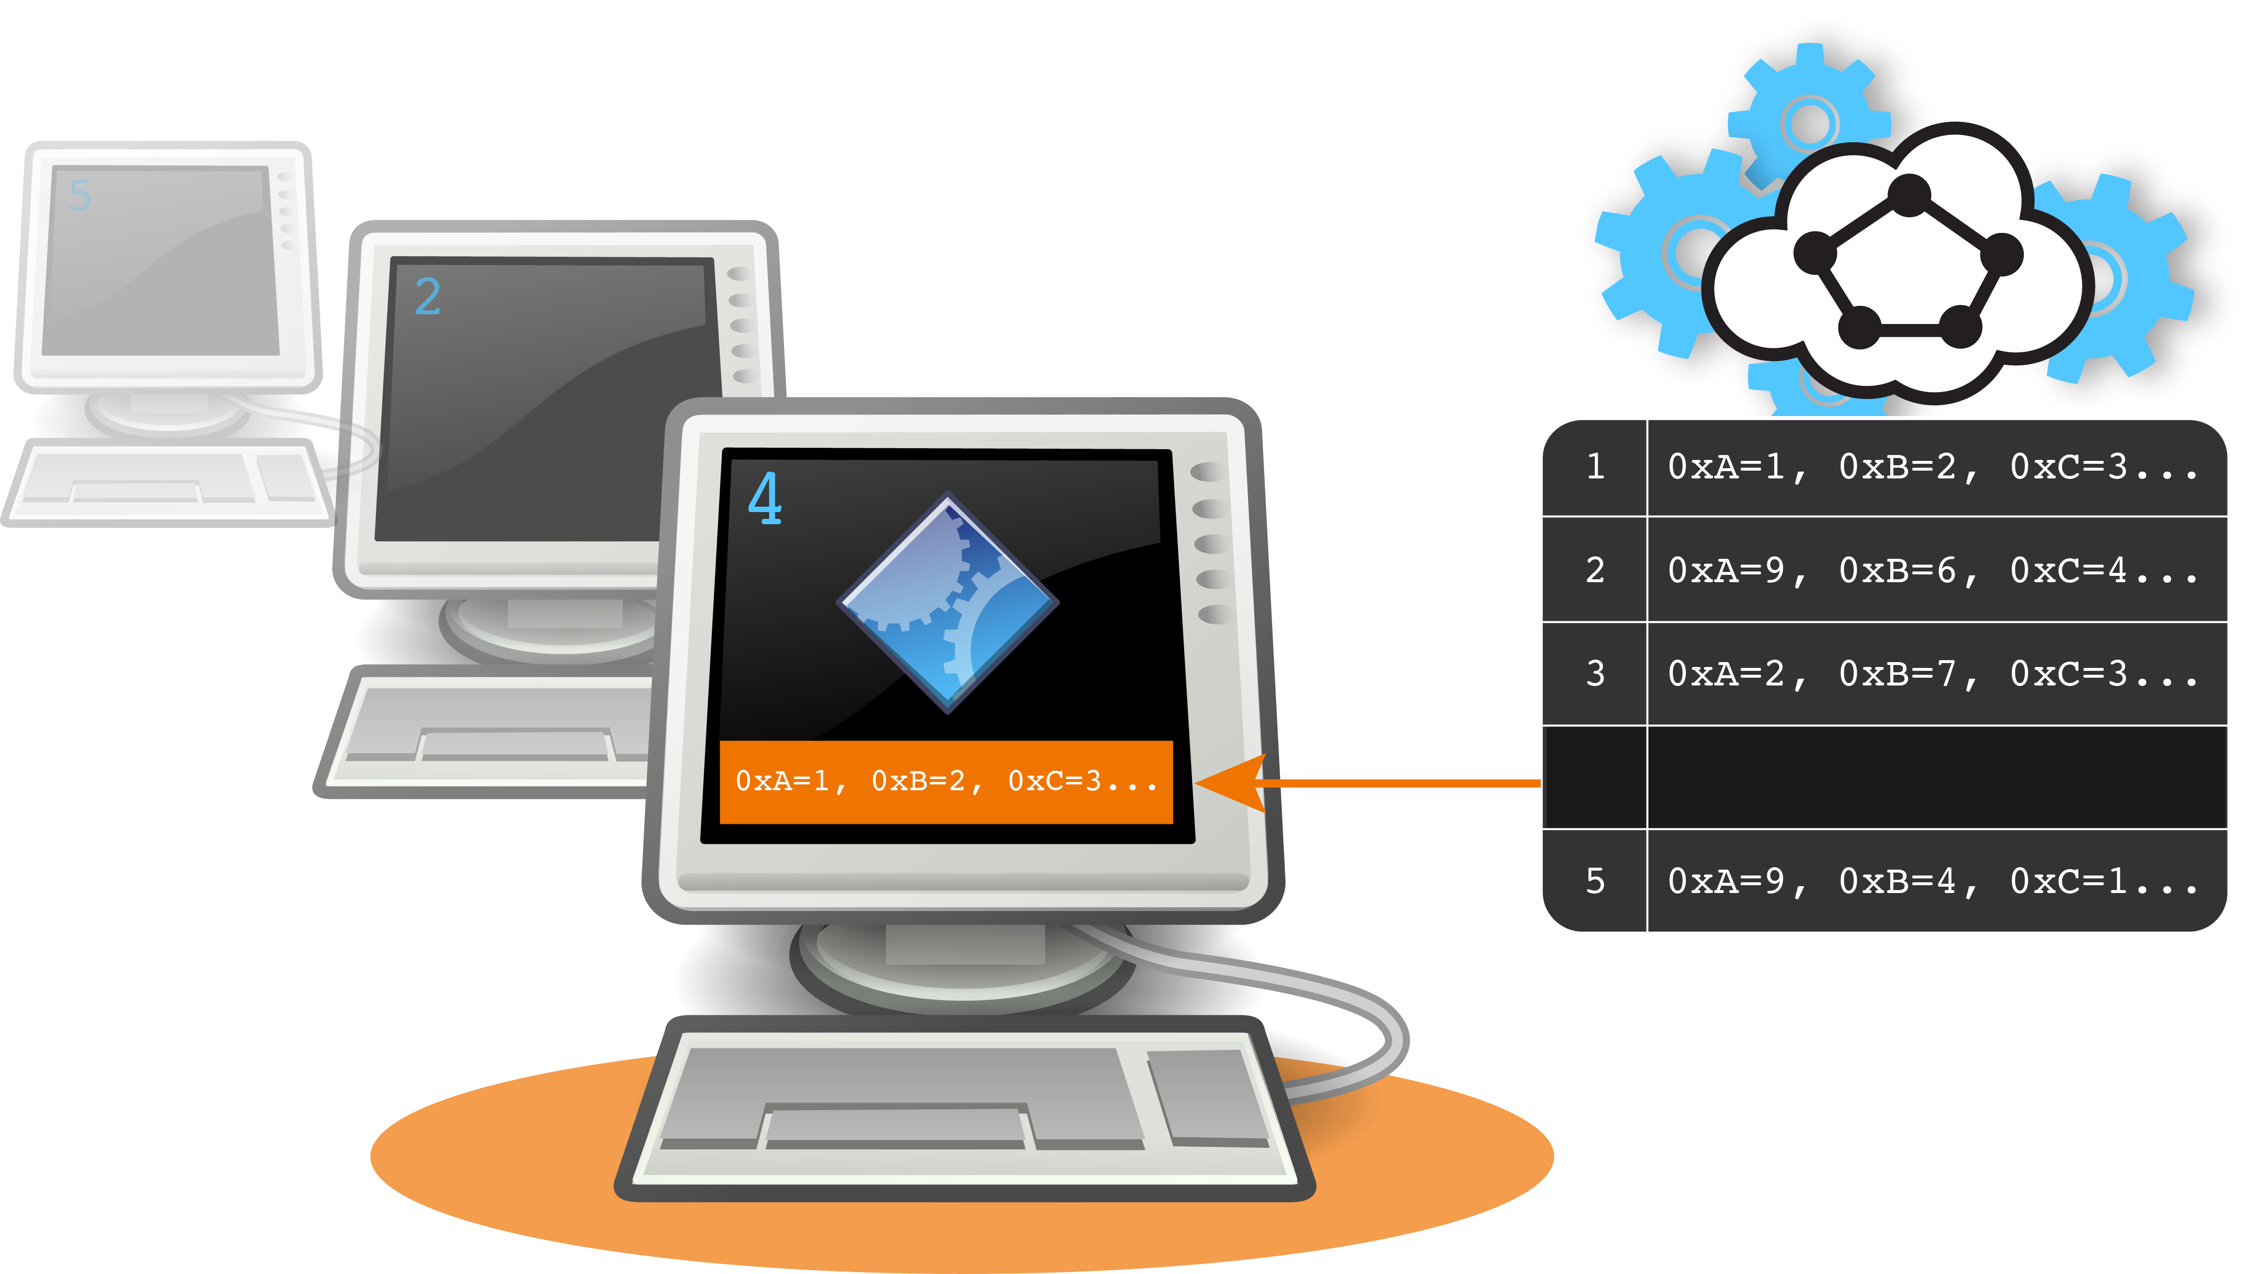
Virtual Context Switching

Slide 23
Shadow-Tor’s Accuracy

Slide 24
Shadow-Tor’s Scalability
Memory: 20-30 MiB per virtual Tor host

Slide 25
Outline
Experimentation Ideology
Shadow and its Design
Use case:
Overview: the Distributed Tor Network
Research: the Sniper Attack Against Tor

Slide 26



The Tor Anonymity Network
torproject.org

Slide 27
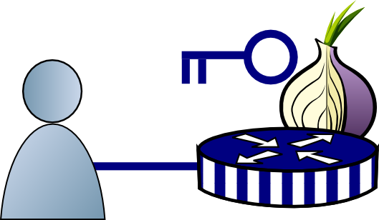
How Tor Works

Slide 28
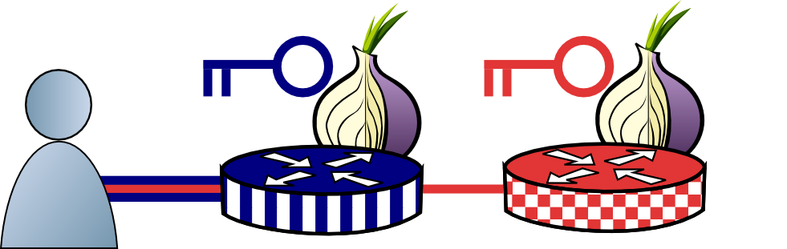
How Tor Works

Slide 29
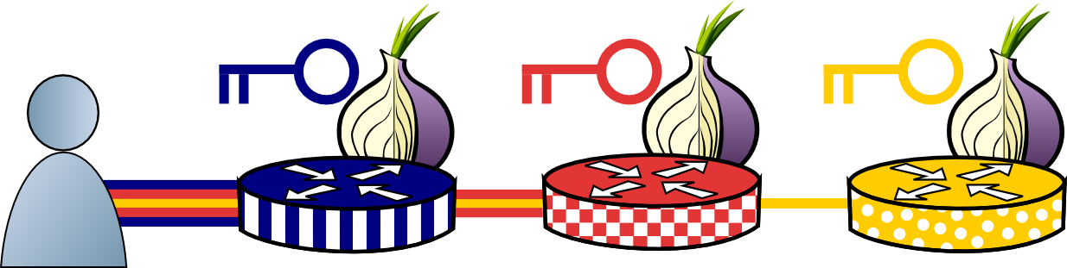
How Tor Works

Slide 30
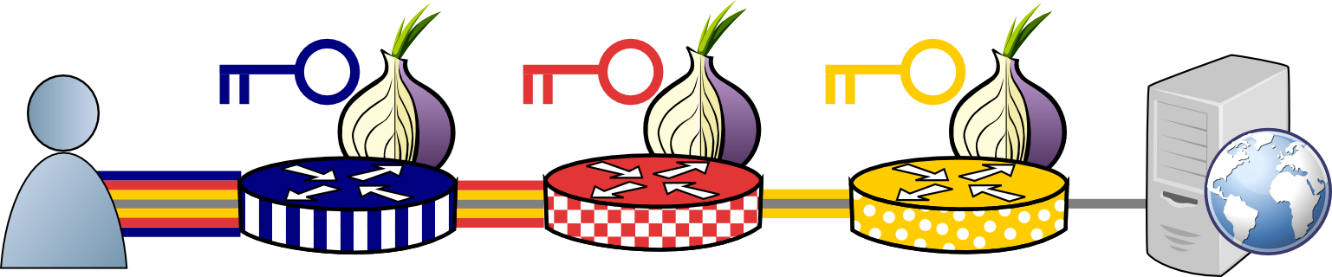
How Tor Works

Slide 31
How Tor Works
Tor protocol aware

Slide 32
Outline
Experimentation Ideology
Shadow and its Design
Use case:
Overview: the Distributed Tor Network
*Research: the Sniper Attack Against Tor
*Joint with Aaron Johnson, Florian Tschorsch, Björn Scheuermann

Slide 33

Tor Flow Control
entry
exit

Slide 34
Tor Flow Control
One TCP Connection Between Each Relay,
Multiple Circuits
entry
exit

Slide 35


Tor Flow Control
One TCP Connection Between Each Relay,
Multiple Circuits
entry
exit
Multiple Application Streams

Slide 36
Tor Flow Control
entry
exit
No end-to-end TCP!

Slide 37
Tor Flow Control
Tor protocol aware
entry
exit

Slide 38
Tor Flow Control
Delivery
End
Packaging End
entry
exit

Slide 39
Tor Flow Control
Delivery
End
Packaging End
entry
exit

Slide 40
Tor Flow Control
SENDME Signal Every 100 Cells
1000 Cell Limit
entry
exit

Slide 41
The Sniper Attack
Low-cost memory consumption attack
Disables arbitrary Tor relays
Anonymous if launched through Tor

Slide 42

The Sniper Attack
Start Download
entry
exit
Request

Slide 43
The Sniper Attack
Reply
entry
exit
DATA

Slide 44
The Sniper Attack
Package and Relay DATA
DATA
entry
exit
DATA

Slide 45
The Sniper Attack
Stop Reading from Connection
DATA
DATA
R
entry
exit
DATA

Slide 46
The Sniper Attack
DATA
DATA
DATA
DATA
DATA
DATA
DATA
R
entry
exit
DATA

Slide 47
The Sniper Attack
DATA
DATA
DATA
DATA
DATA
DATA
DATA
DATA
DATA
DATA
DATA
DATA
R
entry
exit
DATA
Periodically Send SENDME
SENDME

Slide 48
The Sniper Attack
DATA
DATA
DATA
DATA
DATA
DATA
DATA
DATA
DATA
DATA
DATA
DATA
R
entry
exit
DATA
Out of Memory, Killed by OS

Slide 49
Memory Consumed over Time

Slide 50
Mean RAM Consumed, 50 Relays

Slide 51
Mean BW Consumed, 50 Relays

Slide 52
Sniper Attack Defenses
Authenticated SENDMEs
Queue Length Limit
Adaptive Circuit Killer

Slide 53
Circuit-Killer Defense

Slide 54
Sniper Attack Implications
Reduce Tor’s capacity
Network Denial of Service
Influence path selection (selective DoS)
Deanonymization of hidden services

Slide 55
Outline
Experimentation Ideology
Shadow and its Design
Use case:
Overview: the Distributed Tor Network
Research: the Sniper Attack Against Tor

Slide 56

Questions?
shadow.github.io
github.com/shadow
cs.umn.edu/~jansen
rob.g.jansen@nrl.navy.mil
think like an adversary

